Slide 1



Graduate Employment and Skills Analysis
PRESENTATION BY
Vaishnavi Kenjale

Slide 2

contents
01
02
03
04
05
06
OVERVIEW
OBJECTIVES
ER DIAGRAM
DATA POPULATION
SQL QUERIES
CONCLUSION

Slide 3

Overview
The "Graduate Employment and Skills Analysis" project aims to understand how recent graduates are finding jobs and which skills help them get employed. By looking at factors like what they studied, their degree, and their skills, the project will identify job market trends and the most important skills for employment.

Slide 4
OBJECTIVES
The objective of this project is to analyze and understand the factors that influence the employment prospects of recent graduates. This includes examining the impact of academic performance, acquired skills, extracurricular activities, internship experiences, and other relevant factors on the ability of graduates to secure employment after completing their degrees.

Slide 5
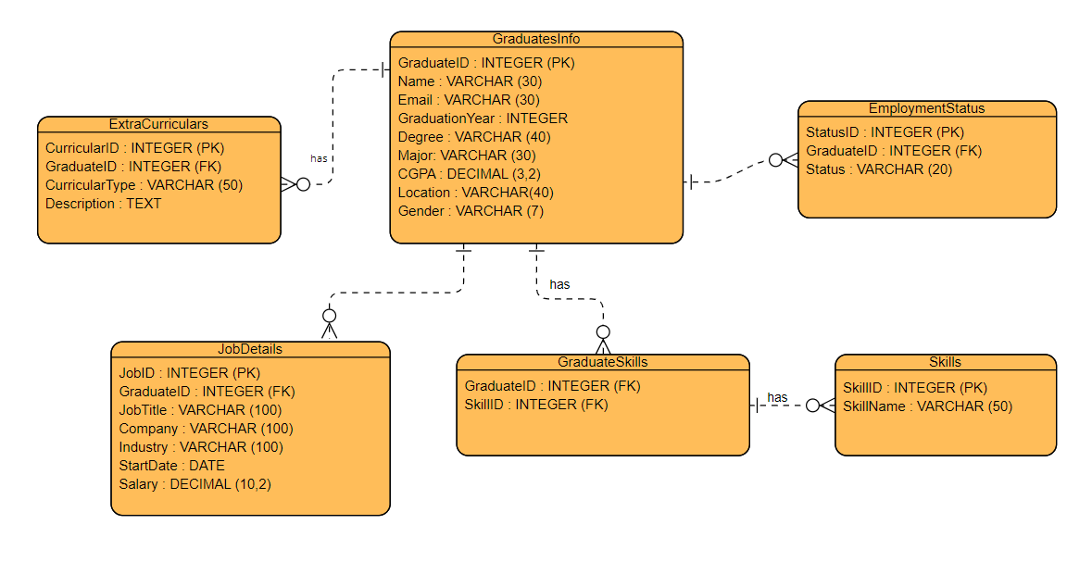
ER DIAGRAM

Slide 6
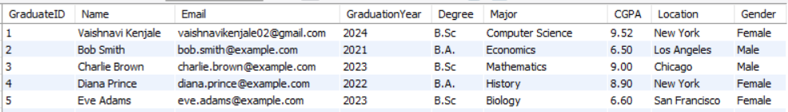
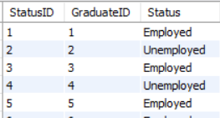
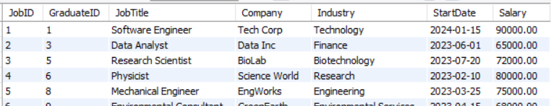



DATA POPULATION
SELECT * FROM GraduatesInfo;
EmploymentStatus
JobDetails

Slide 7
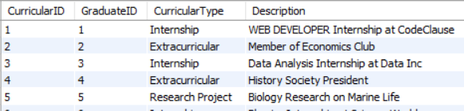
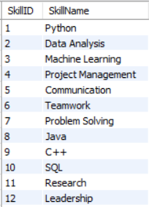
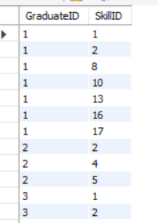



DATA POPULATION
ExtraCurriculars
Skills
GraduateSkills

Slide 8


SQL QUERIES
The count of employed and total count of graduates for each gender, ordered by the count of employed graduates in descending order.
SELECT a1.Gender,
COUNT(CASE WHEN a2.Status = 'Employed' THEN 1 END) AS Count_Of_Employed, COUNT(a1.GraduateID) AS Total_Count
FROM GraduatesInfo a1
LEFT JOIN EmploymentStatus a2
ON a1.GraduateID = a2.GraduateID
GROUP BY a1.Gender
ORDER BY Count_Of_Employed DESC;

Slide 9

Average Salary by Gender and Degree and Average Salary rounded down to the nearest integer
SELECT g.Gender,
g.Degree,
FLOOR( AVG ( j.Salary ) ) AS Average_Salary
FROM GraduatesInfo g
JOIN JobDetails j
ON g.GraduateID = j.GraduateID
GROUP BY g.Gender, g.Degree
ORDER BY Average_Salary ;

Slide 10

Employment rates between graduates with high CGPA and low CGPA
SELECT ROUND ( AVG ( CASE WHEN CGPA >= 4 AND Status = 'Employed' THEN 1 ELSE 0 END ) * 100, 2 ) AS HighGPAEmploymentRate,
ROUND ( AVG ( CASE WHEN CGPA <= 3.5 AND Status = 'Employed' THEN 1 ELSE 0 END ) * 100, 2 ) AS LowGPAEmploymentRate FROM GraduatesInfo g
JOIN EmploymentStatus e
ON g.GraduateID = e.GraduateID;

Slide 11
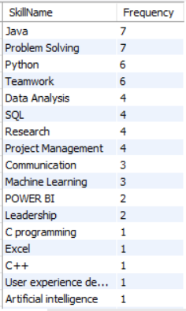
Skills are most common among employed graduates
SELECT s.SkillName, COUNT(*) AS Frequency
FROM GraduateSkills gs
JOIN Skills s
ON gs.SkillID = s.SkillID
JOIN EmploymentStatus e
ON gs.GraduateID = e.GraduateID
WHERE e.Status = 'Employed’
GROUP BY s.SkillName
ORDER BY Frequency DESC;

Slide 12
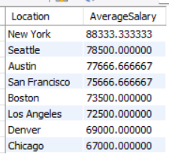
Location of graduates and average salaries
SELECT g.Location,
AVG(j.Salary) AS AverageSalary
FROM GraduatesInfo g
JOIN JobDetails j
ON g.GraduateID = j.GraduateID
GROUP BY g.Location
ORDER BY AverageSalary DESC;

Slide 13

Graduates with internship experiences have higher employment rates or not
SELECT
ROUND(AVG(CASE WHEN f.CurricularType = 'Internship' AND e.Status = 'Employed' THEN 1 ELSE 0 END) * 100, 2) AS InternshipEmploymentRate,
ROUND(AVG(CASE WHEN f.CurricularType <> 'Internship' AND e.Status = 'Employed' THEN 1 ELSE 0 END) * 100, 2) AS NoInternshipEmploymentRate
FROM ExtraCurriculars f
JOIN EmploymentStatus e
ON f.GraduateID = e.GraduateID;

Slide 14
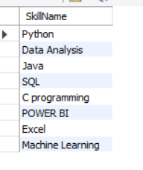
Get the names of skills that graduates have if they have jobs paying more than 80,000$ . Make sure each skill name appears only once in the results.
TOP Skills of high salary graduates
SELECT s.SkillName
FROM Skills s
JOIN GraduateSkills gs
ON s.SkillID = gs.SkillID
JOIN JobDetails jd
ON jd.GraduateID = gs.GraduateID AND salary > 80000
GROUP BY s.SkillName;

Slide 15

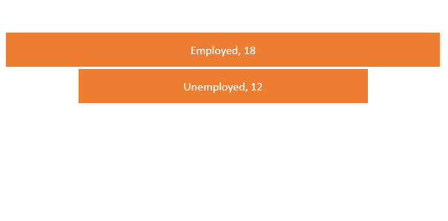
Count of Employed and Unemployed
SELECT Status,
COUNT(*) AS "Count Of Graduates“
FROM EmploymentStatus
GROUP BY Status
ORDER BY "Count Of Graduates" ;

Slide 16
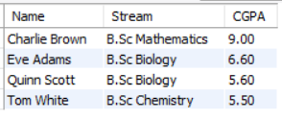
Graduate students in 2023 and CGPA is greater than 5. Order By CGPA in descending order.
SELECT Name,
CONCAT(Degree, " ", Major) AS Stream, CGPA
FROM GraduatesInfo
WHERE GraduationYear = 2023 AND CGPA > 5
ORDER BY CGPA DESC;

Slide 17
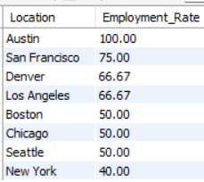
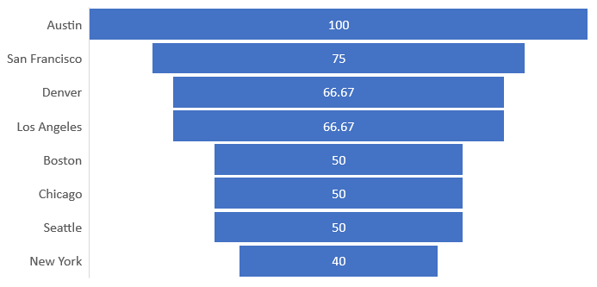
Employment Rate By Location
SELECT gi.Location,
ROUND(COUNT(CASE WHEN es.Status = 'Employed' THEN 1 END) * 100.0 / COUNT(*), 2) AS Employment_Rate
FROM GraduatesInfo gi
JOIN EmploymentStatus es
ON gi.GraduateID = es.GraduateID
GROUP BY gi.Location
ORDER BY Employment_Rate DESC, Location;

Slide 18

CONCLUSION
conclusion
This project looked at what helps graduates get hired after college. I found that it's not just about good grades, but also having the right skills, experiences like internships, and other factors like location. By understanding these key ingredients, we can better prepare graduates for success in the job market.

Slide 19


THANK YOU
vaishnavikenjale02@gmail.com
https://www.linkedin.com/in/vaishnavi-kenjale-09a1b01ba/
https://www.linkedin.com/in/vaishnavi-kenjale-09a1b01ba/

